Slide 1
CSE260
Revision Final

Slide 2
MSI
a) Implement the following function with 8:1 mux
F(A,B,C,D) =∑(0,1,3,4,8,9,15)
b) Construct AND, OR and NOT gates using 2:1 MUXes. Then design XOR gate from AND, OR and NOT gates made using 4:1 MUXes.
c) Use a decoder and encoder pair to construct a full adder.
d) Design the function using (1) 3:8 decoder (2) 8:1 mux
A | B | C | F
0 | 0 | 0 | 1
0 | 0 | 1 | 0
0 | 1 | 0 | 0
0 | 1 | 1 | X
1 | 0 | 0 | 1
1 | 0 | 1 | 1
1 | 1 | 0 | X
1 | 1 | 1 | 0

Slide 3
FlipFlops

Slide 4
x
A
J
Find the state equation for A and B
A’
K
Clock
B
D

Slide 5
Solution
JA+=A
KA+=A’Bx
DB+=(A’Bx)’

Slide 6
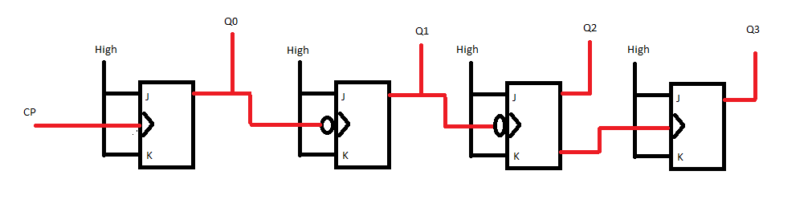
Draw the timing diagram of “Clock pulse (CP), Q1,,Q2,Q3 AND Q4 “ for the above the circuit

Slide 7
Assume that you have to create a sequential circuit where there are only even numbered states. The state starts from 000 state and is composed of 3 flip flops. The circuit will behave as a counter except that when it counts, it increases its value by 2. Hence the odd numbered states never appear and can be considered don’t cares. Just like a counter, the values will go back to 000 after the maximum count of 110 has been reached. Deduce the expressions of the flip flop inputs if the first flip flop made with D flip flop, the second with RS flip flop and the third with JK flip flop. (Draw the state diagram as well)
Draw the circuit diagram for the question in [ a.].

Slide 8
A. Design an asynchronous decade counter using T ff.
B. Design a modulo 12 counter using T ff.

Slide 9
Flipflop
(A) Design the following counter using JK flipflops
000 001 010 100 101 110 000
(B) A sequential circuit has 2 ff, 2 input and an output
JA=xB+y’B’; KA=xy’B’; JB=xA’; KB=xy’+A; z=xyA
Obtain the logic diagram, state table, state diagram

Slide 10
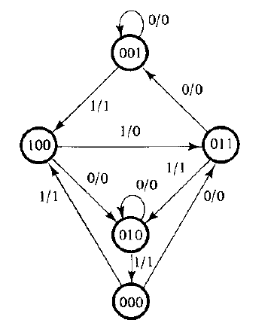
Design the following circuit with T ff

Slide 11
solution
JA=B; KA=B;JB=C, KB=1; JC=B’, KC=1

Slide 12
Shift Registers

Slide 13
Draw the circuit diagram from shift register using D ff with 2 selection pin and behaves as follows: 00-> rotate left 01-> rotate right 10-> parallel load 11-> no change

Slide 14
RAM

Slide 15
RAM
Design a binary cell a) logical b) block
Draw a 8*8 RAM;
Draw the block for 64k x 8 RAM; Using that design (block) a 256k x 8 RAM; Also design the block for 64k x 16 RAM using 64k x 8 RAM

Slide 16
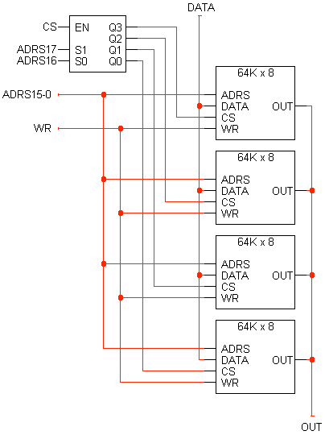
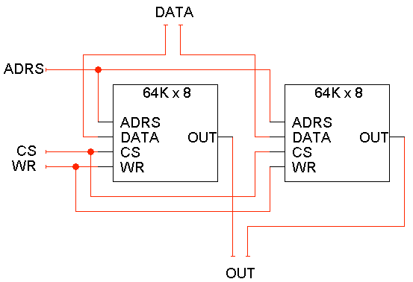
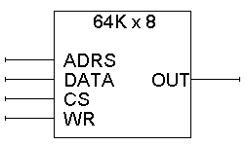
Solution

